Slide 1


RDBMS PROJECT {ONLINE VOTING SYSTEM}
By :
SEJAL BALASAHEB SHIRSALE
Reg no.: 209303345
SEC : E (CCE)

Slide 2



Under the guidance of
Mr. Jitendra Singh Yadav
Name of the Supervisor:
Mr. Jitendra Singh Yadav
Department of Computer and Communication Engineering
School of Computing and Information Technology
Manipal University Jaipur
Jaipur, Rajasthan
Team Members Name and Registration numbers :
Sejal Balasaheb Shirsale (209303345) &Vartika Paharia (209303363)

Slide 3
Introduction: "ONLINE VOTING SYSTEM" refers to an online voting method. People with Indian citizenship who are over the age of 18 and of any gender can vote online without going to a physical polling station under this system. A database is kept in which all the names of voters with complete information are stored. A voter can use his or her voting right online without difficulty in the "ONLINE VOTING SYSTEM". Objectives/Aim: In the "Voting Rights Exercise System", voting rights can be exercised and voting rights can be exercised. To register yourself, you need to fill out the registration form. All entries are checked by a database that already contains all the information about the voters. If all entries are correct, the voter will receive a user ID and password that can be used to vote. If the condition is false, this entry will be discarded.

Slide 4
Technical Details: This project will be a Web application to be developed in PHP having Database Design (My SQL) Form Design (HTML 4.0) And CSS Coding (PHP) Testing (XAMPP SERVER) Reporting Tool (Data Report) Web browsers: Mozilla Firefox, Google chrome, Opera and Internet. Microsoft Windows with- Memory: 512 MB Disk space: 750 MB of free disk space
Methodology:
(Methodology will include the steps to be followed to achieve the objective of the project during the project development. Graph: Literature, Design, Implementation, Results and Conclusions, Report Writing)

Slide 5
Market Potential & Competitive advantages: Service that is quick and simple. The online voting system is more time-efficient. It reduces paperwork and makes the job easier for the ELECTION COMMISSION. It is a more efficient method of voting. The voting percentage will skyrocket as a result of this. It is simple to use because voters do not need to go to a polling place. This framework will increment the voting rate in India. Bibliography / References: http://www.wikipedia.com/

Slide 6
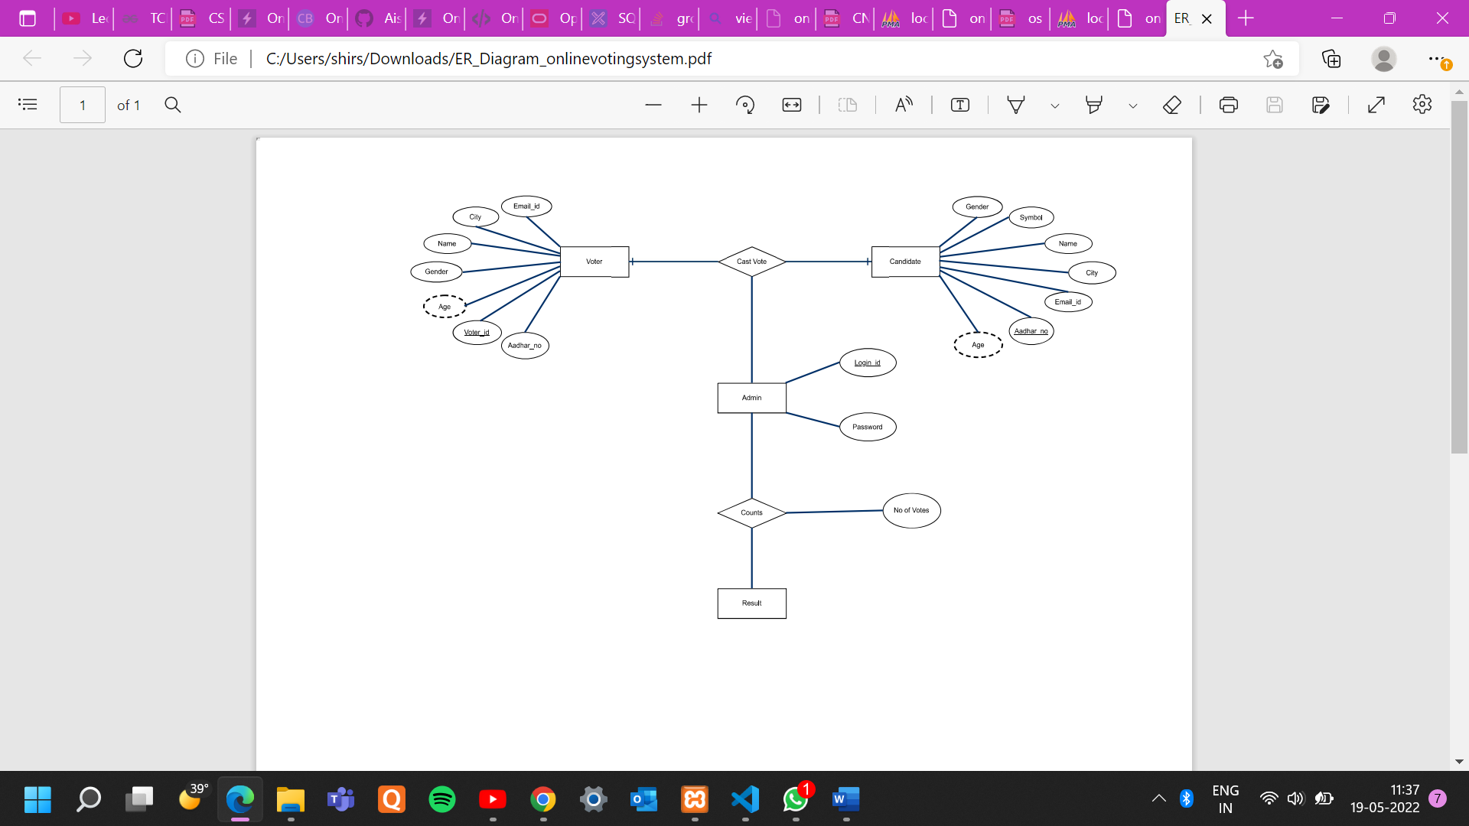
ER DIAGRAM:

Slide 7
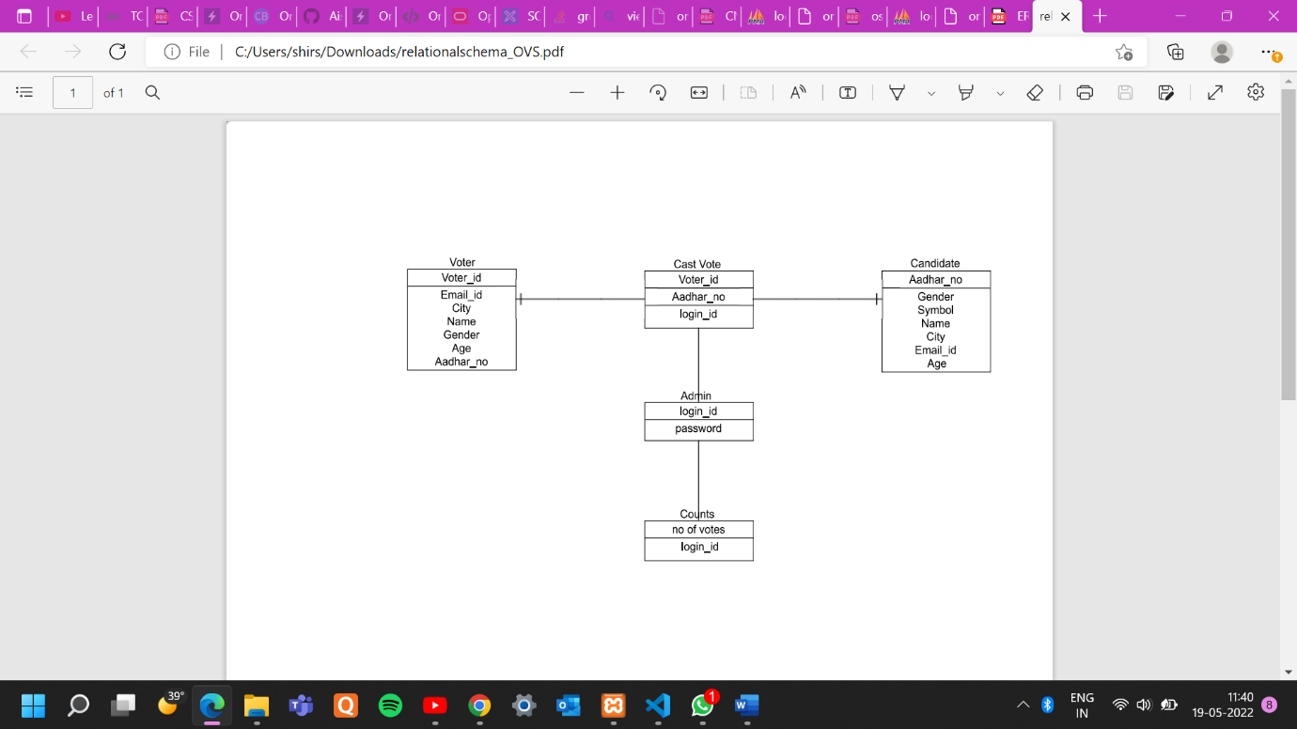
RELATIONAL SCHEMA:

Slide 8
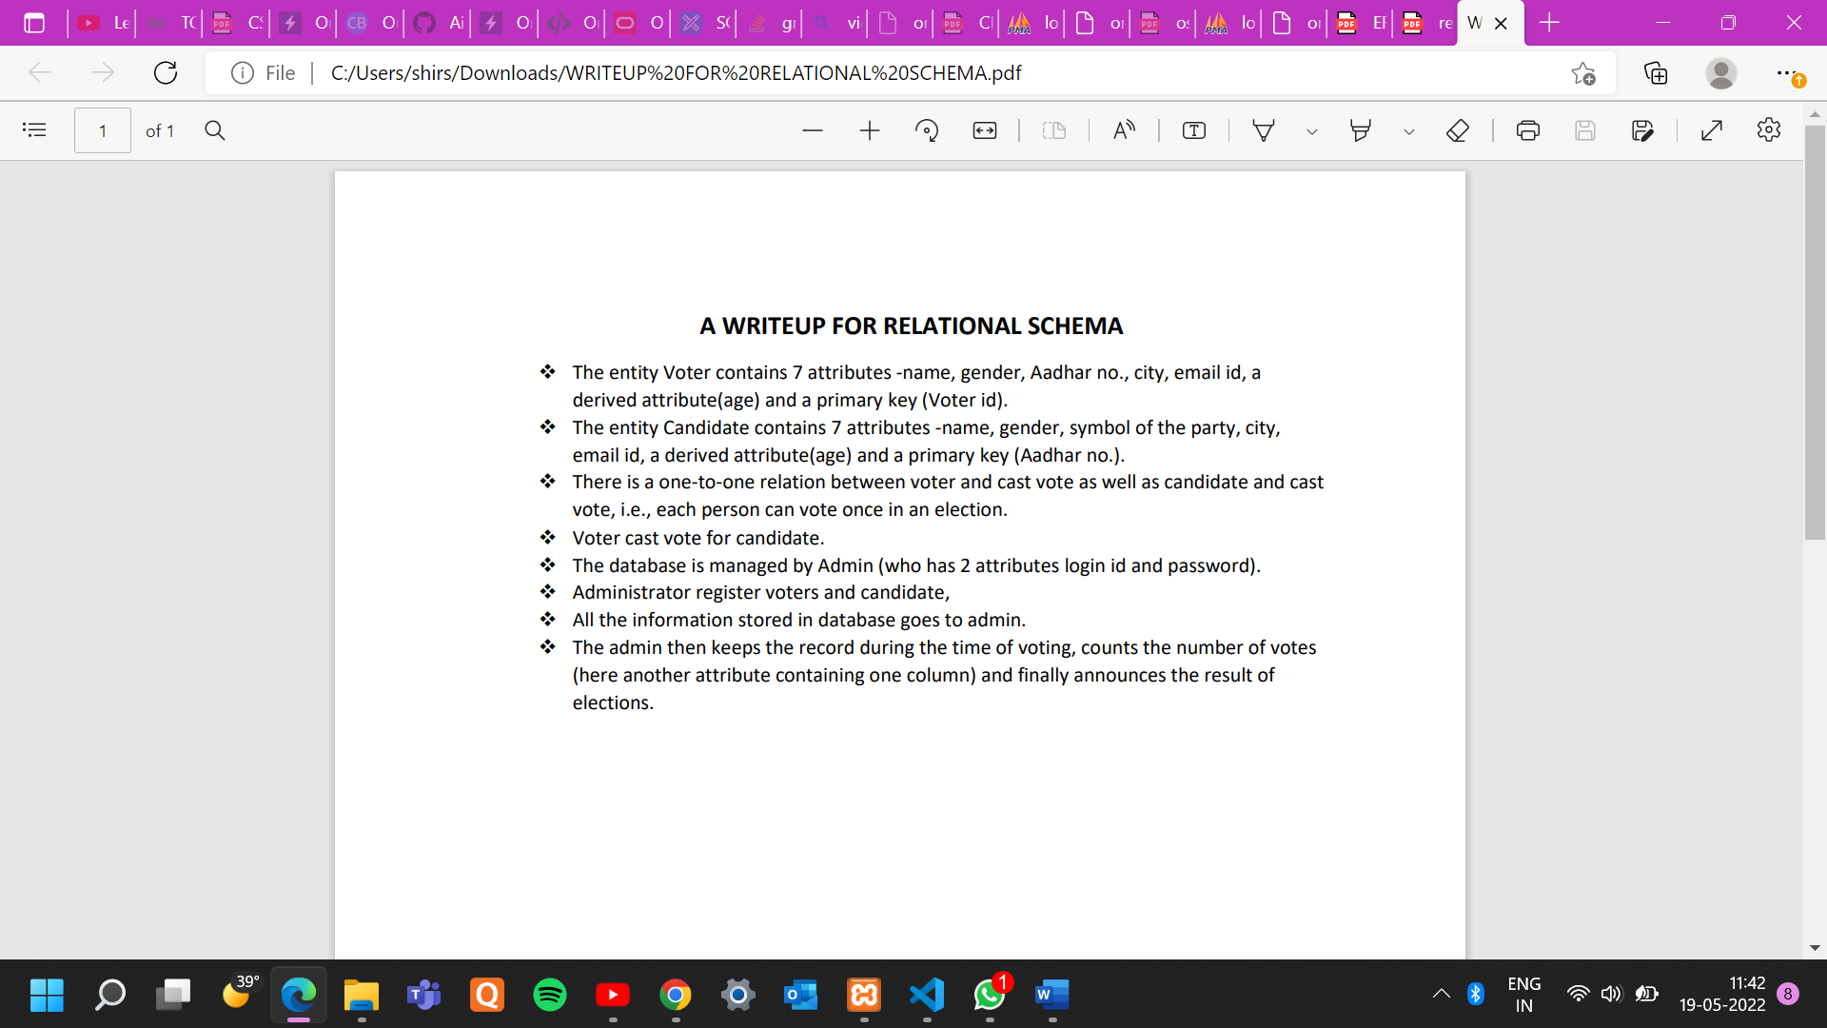

Slide 9
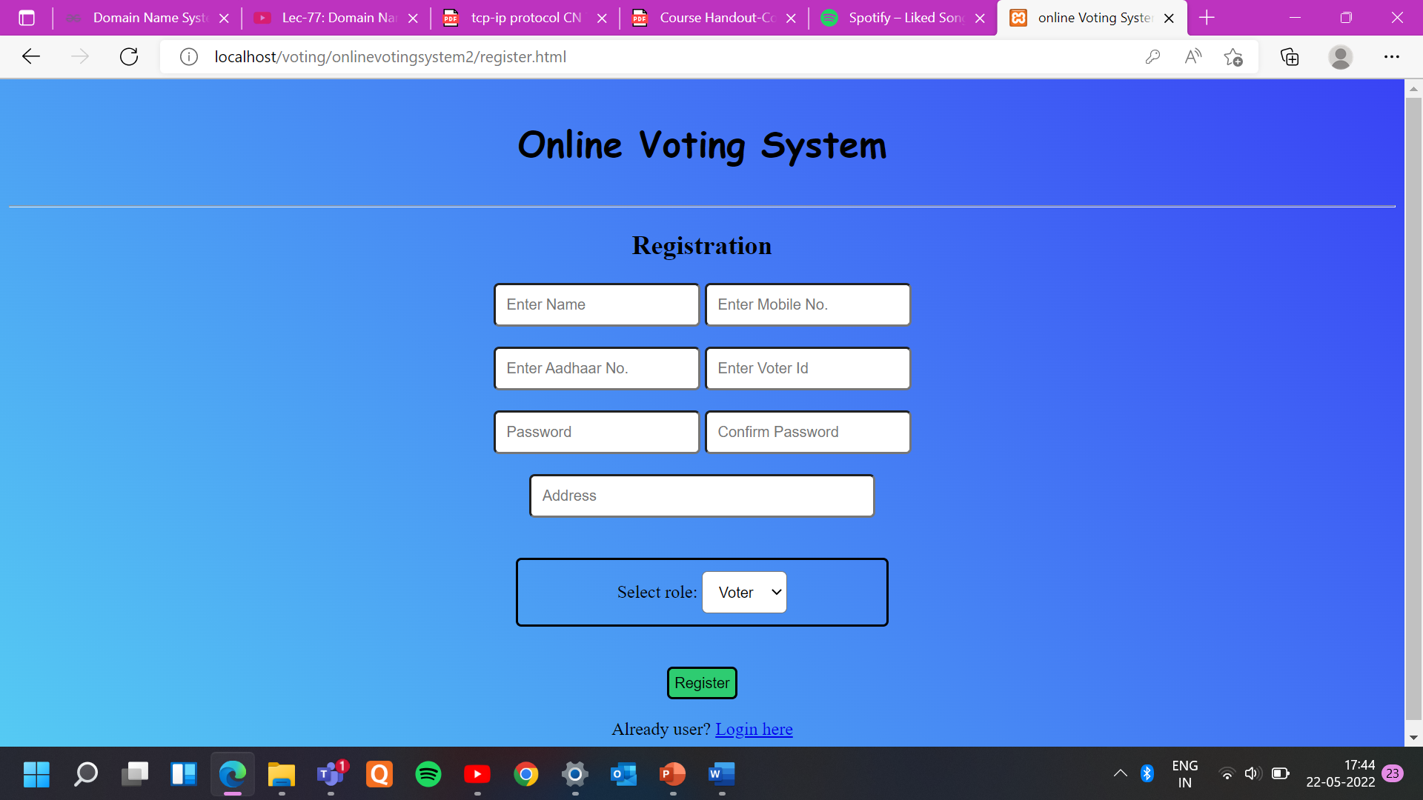
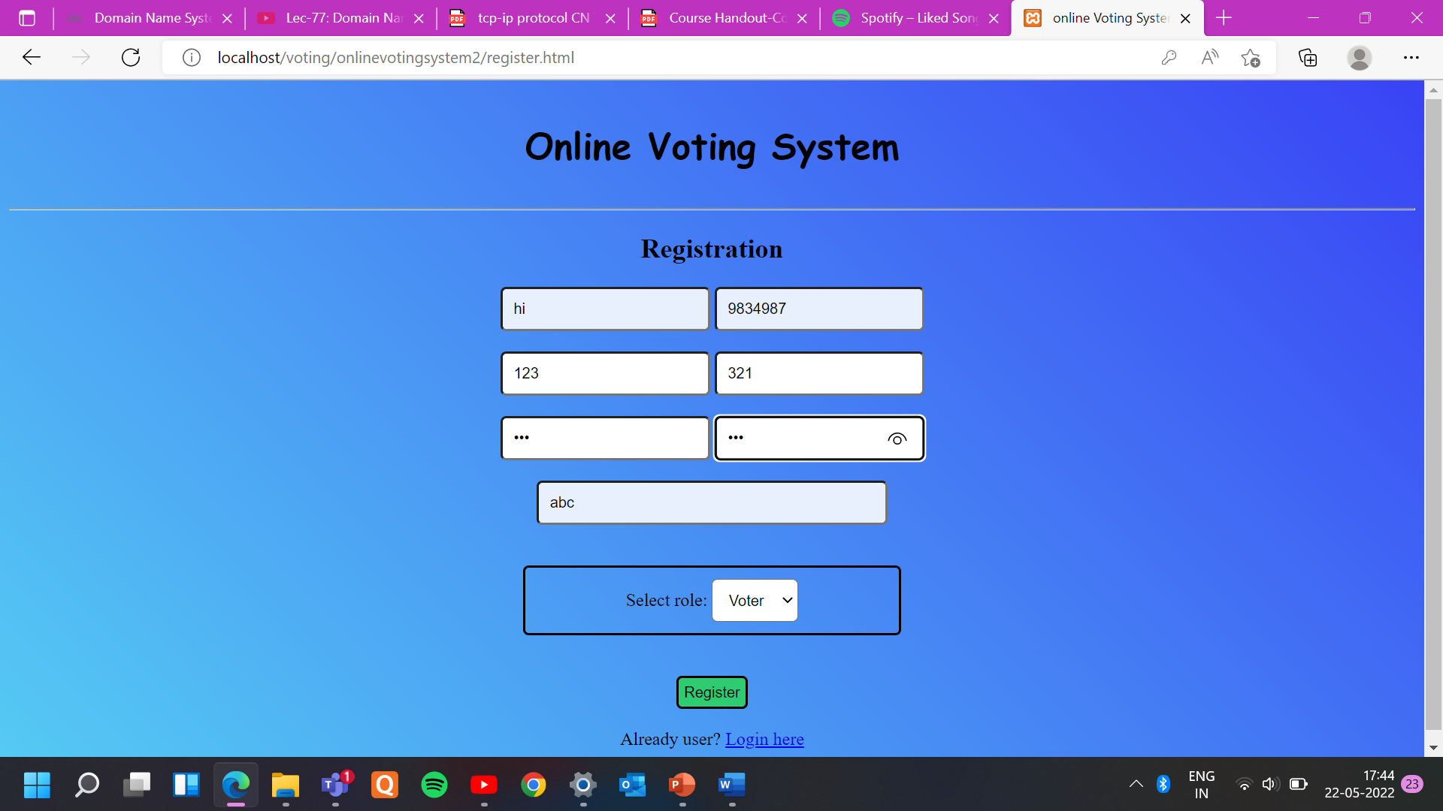

Snapshots :

Slide 10
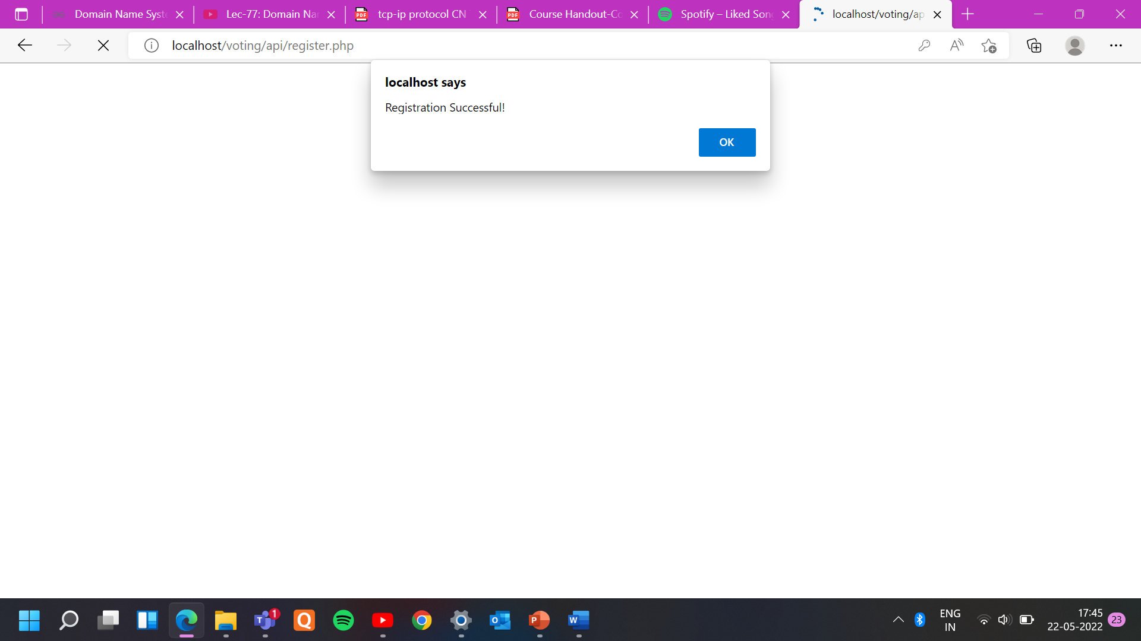
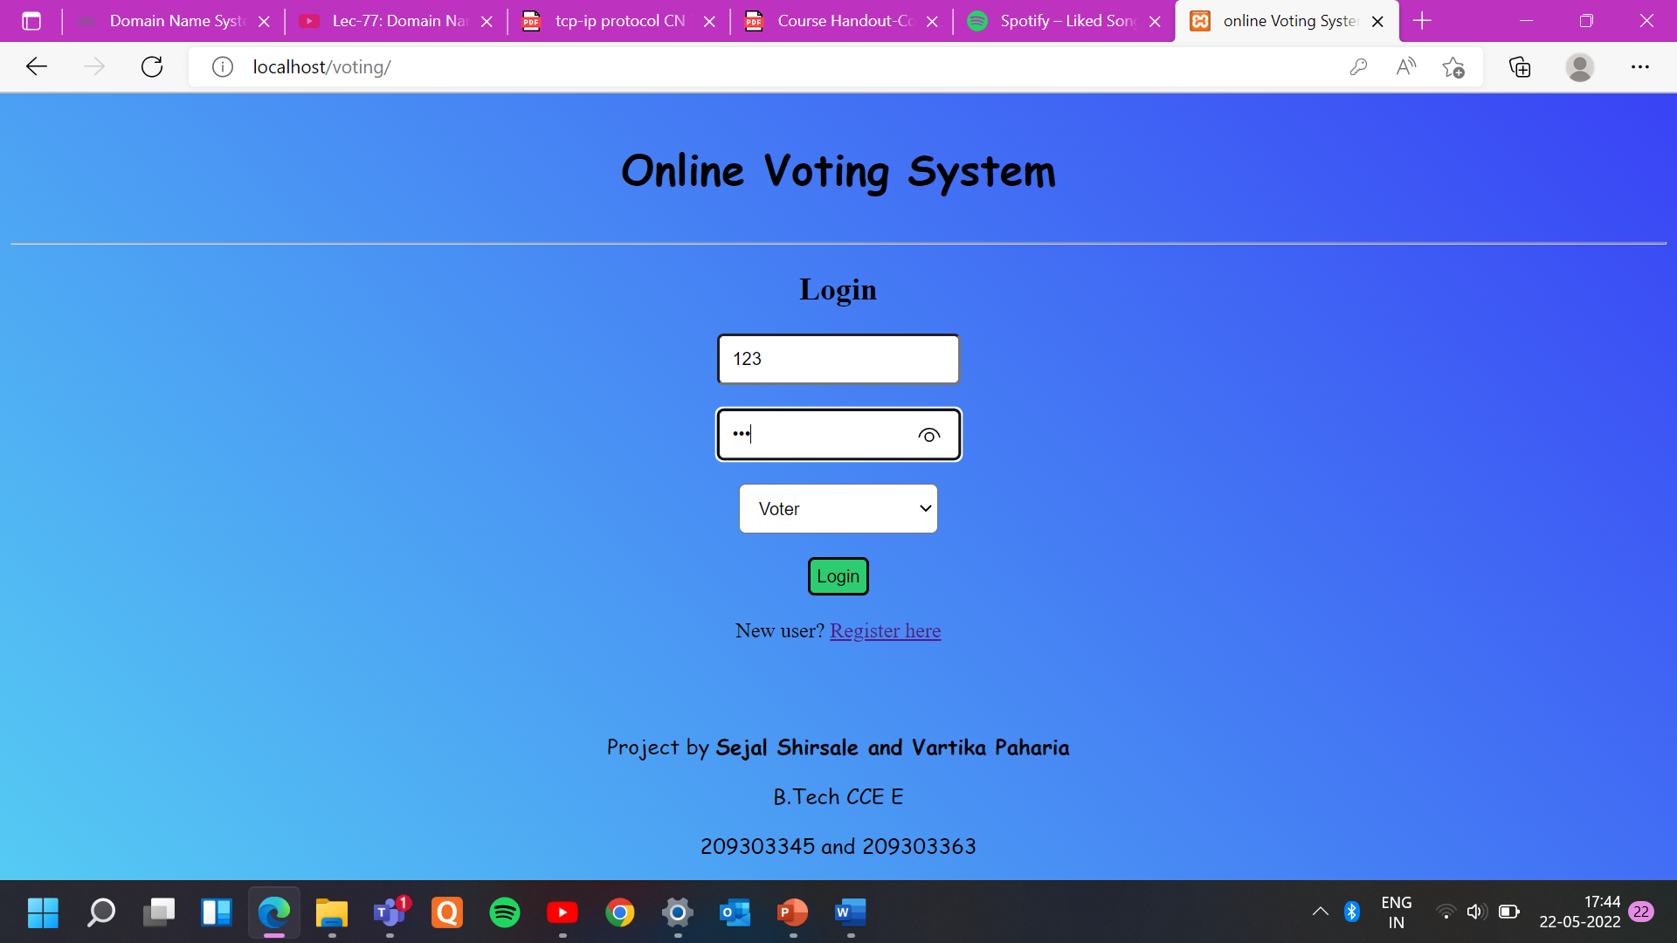
Snapshots :

Slide 11
THANKYOU

